Slide 1
Simplicity is the ultimate complexity.
Leonardo Da Vinci
Informatio Medicata
Budapest, 22-23 september 2011
Iulian Herciu
Notes:
PQ EntreP: 2011 CODie Finalist – other finalists were…SIIA CODie awards are given to products deemed to be the most innovative and best in their category.
Thanks you all for coming to the ProQuest session.
In keeping with the theme of Demonstrating Value – I’m going to talk a bit about how to get extra value from our business products and also a significant amount of extra value added recently.

Slide 2
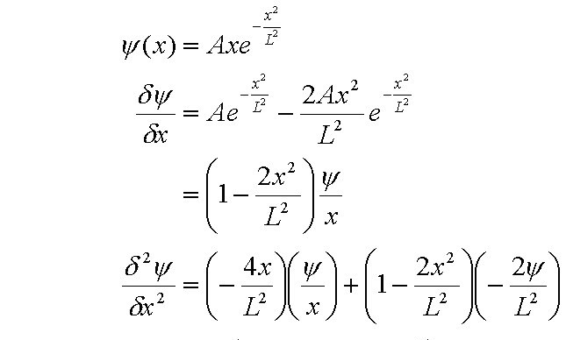
Challenge of today's researcher: Limited time to scan a discipline
Data Collection
Collaboration
Formulation of Question
Observational
Intuition
Theoretical
Communication
Experimental
Publication
Presentation

Slide 3
Collaboration RefWorks
Web based research management tool designed for bibliographic references
Create a personal database online from multiple databases
Attach PDFs and other files to references
Organize, manage and share references
Web based - no need to load program software on any machine
Unlimited remote and mobile user access
Grab bibliographic information from webpages with RefGrab-It
Format bibliographies and manuscripts in seconds

Slide 4
Data Collection ProQuest Dissertation and Thesis
ProQuest is the Official Repository of the US Library of Congress and National Library of Canada
All top ranking research universities – as defined by the Carnegie Foundation - work with UMI
40% of PhDs from the world’s top universities are published in PQDT
More than 3,000 libraries around the world subscribe to PQDT - including most of the world’s leading universities
Over 2,000,000 full-text dissertations

Slide 5
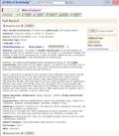
Data Collection Dissertation Citation Index
From single record within PQDT, a search can be expanded by following the links designed to drive discovery.
Move Backward in time via Cited References,
Move forward in time via Times Cited
2006
2007
2005
Related Records
2005
Cited References
Times Cited
2004
2002
2005
← Citing ←
1999
2006
2007
1994
“On a scale of 1 to 10, I would say it would be a 10, I think once somebody has located the dissertation, they need to be able to use that information and make more use of that information which they would be able to do if the citations were clearly marked in the electronic source.” – University of Birmingham
1999

Slide 6
Data Collection Proquest Medical Complete
ProQuest Health and Medical Complete
2,100 Full-text journals
clinical and healthcare disciplines, including medical sciences, immunology, pharmacy and pharmacology, nursing, physical fitness and hygiene, surgery, and others
Combines the clinical research with additional consumer and health administration titles
ProQuest Health Management
ProQuest Family Health
High impact-factor journals
Evidence-based resources
Doctoral dissertations
Cultural competence in healthcare
Nursing procedures on video
Nursing reference ebooks
Clinical reference
ProQuest Psychology Journals
ProQuest Nursing & Allied Health Source
Notes:
The delivery of health care services - in a manner that is respectful and appropriate to an individual’s culture, is more than simply a patient’s right, but is, in fact, a key factor in the safety and quality of patient care.”
The New England Journal of Medicine
The Lancet
Annals of Internal Medicine
Journals of Clinical Investigation
Gout
Diabetes
Chest
Heart

Slide 7
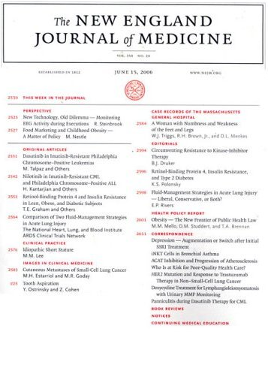
Data Collection Proquest Medical Complete
Coverage Starts 1996+
Embargo: 90 days
Publisher: Massachusetts Medical Society, Publishing Division
Subject: MEDICAL SCIENCES
Impact Factor: 50.017
Features in Brandon Hill Medical List, “Starred” title
Features in Core Collection List
Awarded 10 / 10 in study by Florida State University
Notes:
White/plain background slide, useful when large charts or graphics are needed.

Slide 8
Data Collection Proquest Medical Complete
Coverage Starts 1990+
Embargo: 60 days
Publisher: Elsevier
Subject: MEDICAL SCIENCES
Impact Factor: 28.409
Features in Brandon Hill Medical List, “Starred” title
Features in Core Collection List
Awarded 9 / 10 in study by Florida State University
Notes:
White/plain background slide, useful when large charts or graphics are needed.

Slide 9
Data Collection Proquest Medical Complete
Coverage Starts 2002+
Embargo: None
Publisher: American Society for Clinical Investigation
Subject: BIOLOGY
Impact Factor: 16.559
Features in Brandon Hill Medical List
Features in Core Collection List
Awarded 7 / 10 in study by Florida State University
Notes:
White/plain background slide, useful when large charts or graphics are needed.

Slide 10
Data Collection Proquest Medical Complete
Coverage Starts 2003+
Embargo: None
Publisher: American Thoracic Society
Subject: MEDICAL SCIENCES--RESPIRATORY DISEASES
Impact Factor: 9.792
Features in Brandon Hill Medical List, “Starred” title
Features in Core Collection List
Awarded 10 / 10 in study by Florida State University
Notes:
White/plain background slide, useful when large charts or graphics are needed.

Slide 11
Data Collection Proquest Medical Complete
Coverage Starts 1988+
Embargo: None
Publisher: American Psychiatric Association
Subject: MEDICAL SCIENCES--PSYCHIATRY AND NEUROLOGY
Impact Factor: 10.545
Features in Brandon Hill Medical List, “Starred” title
Features in Core Collection List
Awarded 10 / 10 in study by Florida State University
Notes:
White/plain background slide, useful when large charts or graphics are needed.

Slide 12
Data Collection Proquest Medical Complete
Coverage Starts 1997+
Embargo: None
Publisher: American Diabetes Association
Subject: MEDICAL SCIENCES--ENDOCRINOLOGY
Impact Factor 8.398
Features in Brandon Hill Medical List, “Starred” title
Features in Core Collection List
Awarded 9 / 10 in study by Florida State University
Notes:
White/plain background slide, useful when large charts or graphics are needed.

Slide 13
Data Collection British Nursing Index
Gives users access to the most up to date publications outside of U.S
A simple resource for nurses/ nursing students to navigate particularly the less experienced ones
Cross-searchable with full-text content available in ProQuest Nursing and Allied Health Source
Notes:
Health Information and Libray Journals

Slide 14
Data Collection EBRARY Academic Complete™
Academic Complete™ is the best value in the industry
Low cost per use
Over 70,000 e-books and growing
Unlimited access
Awarded to the CHOICE Outstanding Academic Titles List
Includes DASH! for integrating library documents
Integrated on the ProQuest platform
A sample university with 9,000 FTE pays 47 cents per use, even lower than patron driven acquisition at $3.91!
“Academic Complete is a highly affordable and effective way to provide students with an instant, multi-disciplinary library of e-books from authoritative publishers. Best of all, the collection is available to any number of students at any time and continues to grow at no additional cost.”
- Anne Cerstvik Nolan, Electronic Resources Coordinator, Brown University Library

Slide 15
Data Collection EBRARY subscription model
Affordable, FTE-based pricing
Continued growth at no extra cost
Instant digital library in multiple subject areas
Simultaneous, multi-user access
No additional hosting fee for purchased titles
Academic Databases
Academic Complete™ with DASH!
Business & Economics
College Complete™ with DASH!
Computers & IT
Education
Engineering & Technology
History & Political Science
Humanities
Interdisciplinary & Area Studies
Language, Literature & Linguistics
Publisher Databases
Datamonitor
D&B International Business Reports
Society of Manufacturing Engineers
Other Databases
Public Library Complete
School Collection
Online Sheet Music
Law, International Relations & Public Policy
Life Sciences
Medical
Nursing & Allied Health
Physical Sciences
Psychology & Social Work
Religion, Philosophy & Classics
Sociology & Anthropology

Slide 16
Data Collection EBRARY purchase model
More than 222,800 titles
Pick and choose purchases
Discounted Starter Packs in 25 subject areas
Single or multi-user access
Seamlessly supplements subscription
No additional hosting fee if the library also subscribes
Short-term loans available prior to purchase
Buy access for any number of users

Slide 17
Data Collection EBRARY Patron Driven Acquisition
Cost-effectively meet patron demand and guarantee usage
Generous triggers
10 page views (excluding TOC & index)
10 minutes of real usage
Copies or prints
Narrow selection by subject, publisher, price, and more
Short-term loans available as mediation
Real-time management of profiles
No additional hosting fee if the library also subscribes
Free MARC records
Free MARC records Provided
Library is invoiced for triggered titles
Non-owned titles selected
Patrons ‘trigger’ some titles
Titles enabled on Library ‘channel’

Slide 18
Data Collection EBRARY platform tools
DASH!™ (Data Sharing, Fast)
Easily and cost-effectively transform your electronic documents into a highly discoverable database of information
Easy, do-it yourself uploading—textbooks, theses & dissertations, special collections, yearbooks, etc.
Share your DASH! collections with other institutions and freely online
INFOTOOLS
Portal to other online resources
Link to 3rd party products and services, extending their value
Activated by selecting words

Slide 19
Data Collection ABI Inform Complete
One of the longest-lived and most prominent collection of full-text business content, from a wide variety of top publishers worldwide.
New agreements: American Economic Association, Palgrave Macmilan, The Economist.
Exclusive access to full-text for the Wall Street Journal and Financial Times plus a selection full-text global daily business newspapers
A valuable assortment of Country Briefs and Reports, Market Research and Company Profiles
Thousands of Dissertations and Working Papers for adding critical full-text scholarly resources and results
Notes:
And much more.

Slide 20
Growing…
Data Collection ABI Inform Complete
51% | 65% | 91% | 30% | 34%
Notes:
The last two years has seen unprecedented growth of content accessible via ABI Inform Complete.
But it’s not just been these traditional areas of content that have grown

Slide 21
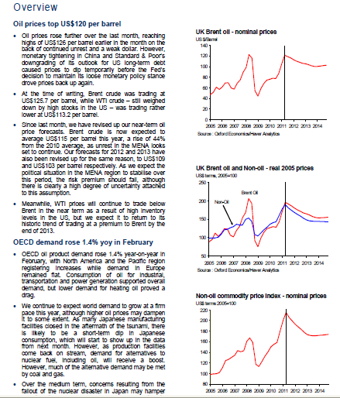
Data Collection ABI Inform Complete
Expands content from market and Industry reports
Notes:
Business Monitor International:
Comprehensive coverage, most reports are over 60 pages
Feature country market overviews,
5 year industry forecasts,
commentary and analysis of risks, competitive landscapes,
trend analysis of latest industry developments & profiles of leading national and multinational companies
Oxford Economics
Leading economic forecasting consultancy
Macroeconomic, industry & commodity forecasts, analysis and data covering 190 countries
One of the things they do very well is ‘even driven’ analysis – so responding quickly to major world events
Hoovers / Dun and Bradstreet
Hoovers company profiles covering over 44,000 companies. The expanded agreement now also includes Hoovers IPO reports, as well as First Research State and Province Profiles
International Labour Organisation

Slide 22
Data Collection ABI Inform Complete
New Agreement: American Economic Association
Notes:
One of the most prestigious scholarly societies in the world
7 Top ranked scholarly journals & EconLit
Available now
Project underway to index back to Vol 1, Issue 1
2-year embargo
This is part of an ongoing committment to increasing the economics content in our business products as well as the overall scholarly content

Slide 23
Data Collection ABI Inform Complete
New Agreement: Palgrave Macmilan
Notes:
Palgrave is an acknowledged leader in scholarly publishing and brings a stable of top ranked titles across multiple disciplines.
The agreement expands our list of journals to 77
Examples of Top Ranked Journals
Journal of International Business Studies
Asian Business & Management
Journal of Information Technology
Acta Politica
Journal of International Relations and Development
Journal of Public Health Policy

Slide 24
Data Collection ABI Inform Complete
New Agreement: The Economist
Country Data Reports
Country Forecast Reports & Country Finance Reports
World Commodity Reports
EIU ViewsWire
Notes:
One of most used publications in ProQuest
Includes print and online only content
Behind pay wall – which is why a deal was done with the Economist and not Business Week for example, where a lot of the content is available on the open web.
Agreement also secures content from the Econmist Intelligence Unit:
Country Data Reports
Country Forecast Reports & Country Finance Reports
World Commodity Reports
EIU ViewsWire

Slide 25
Data Collection SUMMON
A single search box enables quick discovery of the most credible resources anywhere the library has them
Single, unified index – no federated search used!
Pre-harvested full-text and enriched metadata
Content-type and vendor neutral
Superior relevancy algorithms and ranking
Customized to your library’s collection; highly configurable – easy to navigate

Slide 26
Data Collection SUMMON
More content than any discovery solution
Unified Index
Over 700 Million records; 80+ content types

Slide 27
Data Collection SUMMON
Metadata from all sources merged into a single record
Publisher:
Full Text
Agregator: abstracts and subject terms
CrossRef:
DOI
Ulrich’s:
Peer-reviewed status
Web of Science: additional author plus
citation counts

Slide 28
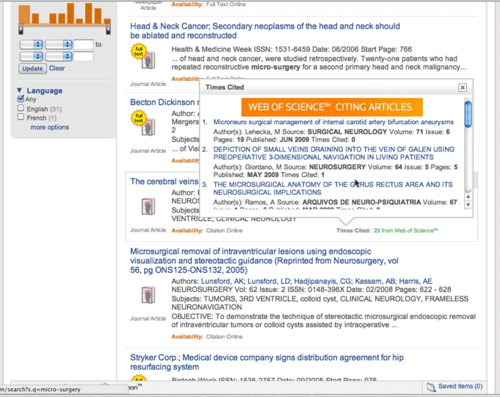
Value-added Content: Web of Science
Data Collection SUMMON
Times Cited counts on Search Results
Counts included in relevancy
Links to citing articles

Slide 29
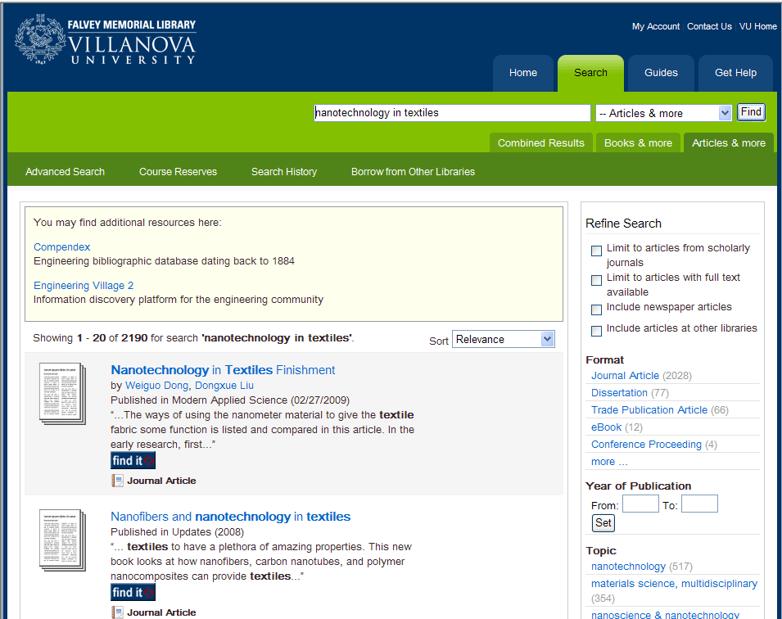
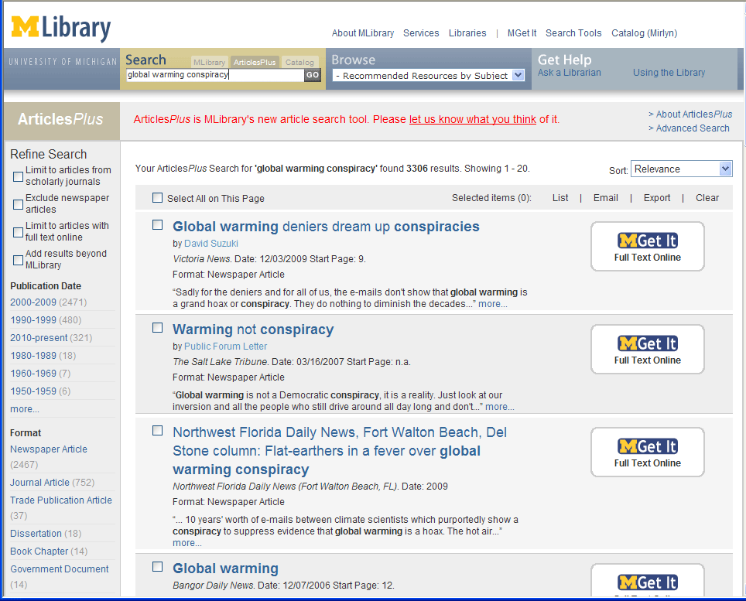
Data Collection SUMMON
API allows development of custom interfaces and applications

Slide 30
ProQuest contribution to today’s challanges
Expanded coverage of core disciplines
PQ Medical Complete
PQ ABI Inform
Ebrary
Wider span of content types:
Periodicals
Non-periodical
Enhanced research collaboration
Integration with other information suppliers
RefWorks
Summon
Internal use only
Notes:
Expanded coverage of core business disciplines
Stronger subject areas than competition
Additional value with specialty business coverage from EntreP, Acct & Tax, Banking, Asian Business
Full integration with IBSS
Wider span of content types
Video, eBooks, downloadable templates, forms, blogs, etc…
Integration on new ProQuest platform

Slide 31
Thank you
Notes:
Select and insert images as appropriate (see “image menu” next slide).
Note that you can remove any of the “image placement” squares by right-clicking and choosing “cut”.

Slide 32
AND ONE MORE THING…
Come to our stand for
PQ LOTERRY

