Slide 1
INCITESTM INSTITUTIONAL PROFILES
Informatio Scientifica / Informatio Medicata
September 2011
David Horky
Country Manager – Central & Eastern Europe
david.horky@thomsonreuters.com
Notes:
Welcome to this introduction to the global Institutional Profiles project. This short presentation will explain the basics of how the project is structured and overview of the some of the services that are possible with this rich source of data.

Slide 2
Introduction & Overview
InCites – Institutional Profiles
The global Institutional Profiles project is an initiative to collect factual data about academic institutions in all regions for the purposes of creating informative profiles of their activities.
The objective is to profile more than 1,000 of the leading academic institutions around the world.
The first use of this data has been to inform Times Higher Education’s World University Rankings.
Thomson Reuters will now also make this information available as a component of InCites, to complement Global Comparisons and Research Performance Profiles.
Notes:
The global Institutional Profiles project is an initiative to collect factual data about academic institutions in all regions for the purposes of creating informative profiles of their activities.
The objective is to profile around 1,000 of the leading academic institutions.
The first use of the data was to inform the Times Higher Education World University Rankings. Which was published, with positive feedback from the community, in September 2010. Future World University Rankings and other comparisons by Times Higher Educations will also rely on the profiles data.
However the rich, comprehensive and robust data in the Institutional Profiles can be utilized in a variety of ways to support institutional comparison and decision making. Thomson Reuters will make the data available in a new product providing access to Institutional Profiles’ data alongside innovative analyses and interpretation.

Slide 3
Three main sources of data
InCites – Institutional Profiles
Academic reputation survey
Bibliometric data
Institution submitted data
Profiles Project
Notes:
There are three main sources of data that feed into the profiles:
Results of the annual academic reputation survey
Data provided by the institutions themselves on staff, students, funding etc.
Bibliometric data based on the publications and citations of the journal articles of the institution

Slide 4
Academic Reputation Survey
InCites – Institutional Profiles
An annual survey of active academics and researchers around the world. Participants are polled to give feedback on the reputation of institutions in their subject area.
A clear distinction between the reputation for Research and that for Teaching
Invitation only.
Multiple languages
Respondents are predominantly academics (2010)
Academic staff 69%
Research staff 15%
Institutional leadership 7%
Graduate/post graduate students 6%
http://science.thomsonreuters.com/globalprofilesproject/gpp-reputational/
Notes:
One of the major components of the profiles project is the annual academic reputation survey.
Annually we conduct a survey of academics and researchers and asked them to provide feedback about what they consider to be the best institutions globally within their subject area.
The survey makes a clear distinction between reputation for research and for teaching.
The survey is by invitation only to prevent institutions from manipulating the results.
The invitations are structured to give a fair balance of different geographic regions and subjects. Additionally, the survey was translated into multiple languages to overcome English language bias. However, even with these efforts to overcome regional bias there are still variations in response rate and post survey results were modified to overcome bias.

Slide 5
Institutional Data Gathering
InCites – Institutional Profiles
Thomson Reuters collects factual data directly from the participating institutions
Thomson Reuters has made considerable efforts to collect high quality, internationally comparable data while minimizing the work burden.
Use existing authoritative data sources when available
Common data definitions for all institutions / countries
Strong support structure
Data validation using third party data
Notes:
The second major source of data is factual data from the institutions themselves. We have the support from the highest level at each of the participating institutions.
Thomson Reuters has made considerable efforts to collect high quality, comparable data with a minimum work burden for the participating institutions.
Use existing data sources when available – for example we used the UK Higher Education Statistics Agency data pre-fill the profiles. So that the institutions have to simply validate the data.
Common data definitions for all institutions - this is the first time that this type of data has been collected on a global scale using a single set of definitions. The definitions are based on existing international standards for statistical reporting of education and research from UNESCO and OECD. To develop and fine tune the definitions we worked closely with our external advisory board.
Strong support structure, detailed documentation, tutorials and webinars etc. – for example in 2010 we ran a series of 15 webinars with several hundred attendees. We also have a team of dedicated data editors, based in region, to answer questions and help participating institutions.
Data validation is very important to us. Validation is done primarily by comparing institutions data submissions to publicly available sources of data such as government reports. We also apply logical validation processes (for example checking to make sure that the number of international students does not exceed the number of students) and outlier identification algorithms.

Slide 6
Bibliometric data
InCites – Institutional Profiles
Utilizes the Thomson Reuters Web of Science data, considered the gold standard by many evaluation bodies globally.
Many bibliometric indicators can be generated. Combinations of bibliometric and institutional data can create new and unique indicators.
Papers per (academic + research staff)
Citation impact
Papers per research $
Research power
Data must be normalized.
Notes:
The third component of data, bibliometric data, relies on the publications authored by the academics and researchers of the institution. The data is sourced from the Thomson Reuters Web of Science, considered the gold standard by many evaluation bodies globally.
Many potential indicators can be generated from this data, such as the total number of papers per subject or the citations per paper.
However, combining bibliometric data and data provided by the institutions can create new and unique indicators of performance, for example papers per research dollar spent as a measure of research effectiveness.

Slide 7
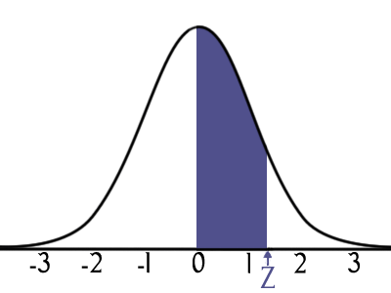
Data Analysis and Interpretation
InCites – Institutional Profiles
Analysis and interpretation of the data is essential.
Modifications of data for comparability.
Benchmarking / normalization:
Data for one institution is compared to the average for the all institutions to understand the performance.
There are fundamental differences in different disciplines and normalization of the data is essential for fair comparisons.
Understand where an institution fits within the distribution of all institutions.
Notes:
Data on its own is difficult to understand. Without understanding of the landscape in which the data sits a single value is a relatively meaningless number. By analyzing and interpreting the data we can turn data and information into meaningful knowledge about institutional performance
Some data needs to be modified for comparability. For example funding data is modified, not just to overcome differences in currency exchange rates but also to overcome differences in the costs of living in difference countries.
Benchmarking and normalization to used to understand the relative performance. We do this by comparing the data of one institution to the average of all institutions, in this way we can determine if a particular value is average, above average or outstanding.
There are also fundamental differences in the characteristics of data for difference disciplines. For example, funding in the medical sciences will typically be higher than for the social sciences reflecting the higher costs of infrastructure that are required. There are also significant differences with regards to publication and citation trends in difference subjects.
By benchmarking data within it’s discipline the data becomes much more meaningful, and it is a unique aspect of the Institutional Profiles project that the same subject classification is used across all the different data types. This type of benchmarking and normalization is essential to make comparisons between universities that have a different subject focus.
Data is also generated to help understand where a university fits in the distribution of all institutions.

Slide 8
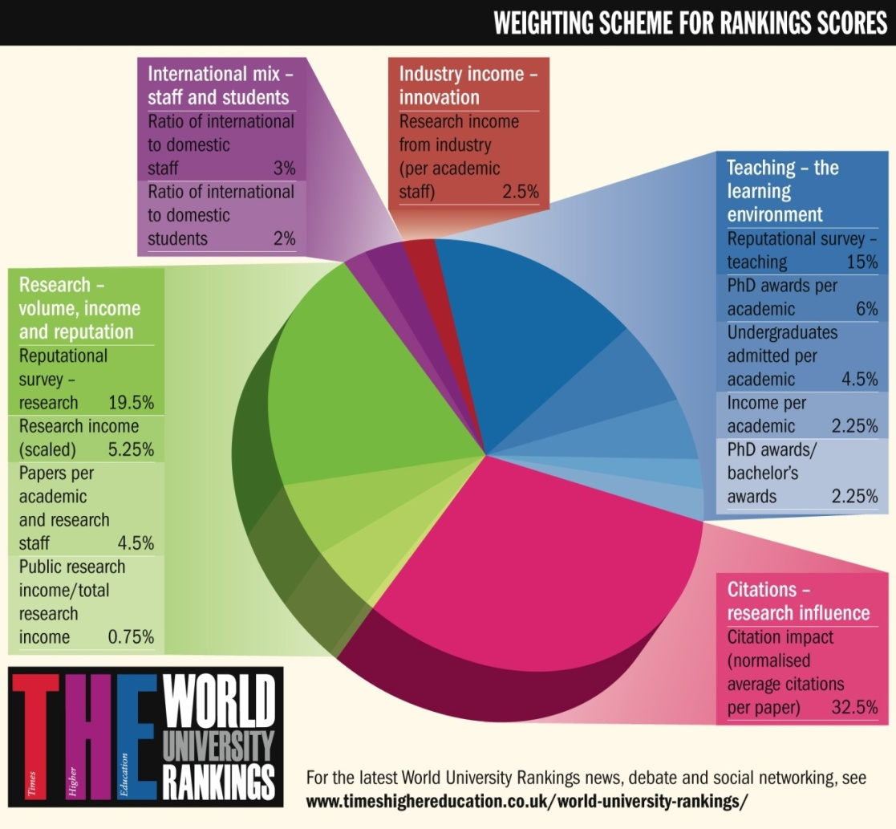
The 2010-2011 Thomson Reuters Methodology
InCites – Institutional Profiles
13 indicators, across five broad areas of a university’s activity, covering the three core missions of every university:
Teaching
Research
Knowledge Transfer
Notes:
Here it is. The final methodology for 2010-11.
13 indicators, across five broad areas of a university’s activity, covering the three core missions of every university: Teaching, research and knowledge transfer.
New teaching section – proxies, but help us get a sense of the learning environment. 30 per cent. No real measures of teaching quality! AHELO perhaps in future.
Reputation reduced to 35 per cent. Down from 50 per cent in old system.
New income measures – no more than 10 per cent. Research 60 per cent.
We are very proud of it, but we also know it is a work in progress.

Slide 9
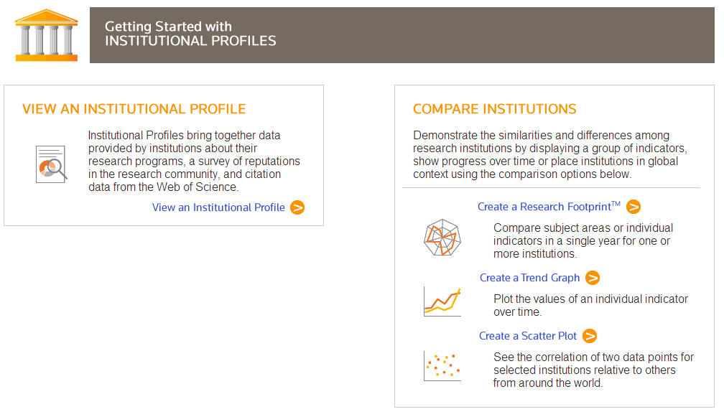
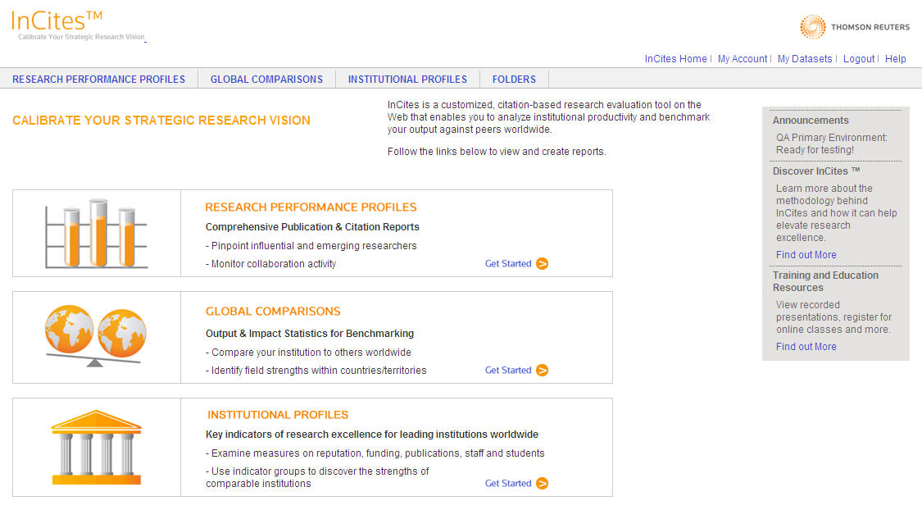
InCites – Institutional Profiles
Approximately 500 institutions from 47 countries.
A Profile exists for each participating institution
Launching in June 2011
Notes:
Data is MIT.

Slide 10
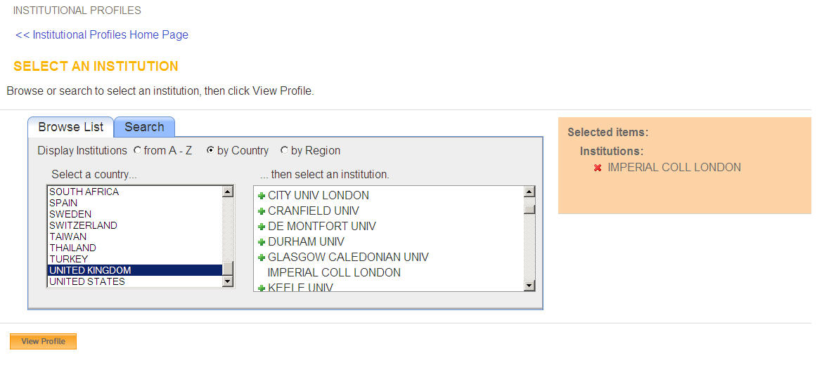
InCites – Institutional Profiles: View an Institutional Profile
Viewing an Institutional Profile is a good intro to general information components as well as radar graphs.
The menu is extremely simple, easy to use.
Notes:
Data is MIT.

Slide 11
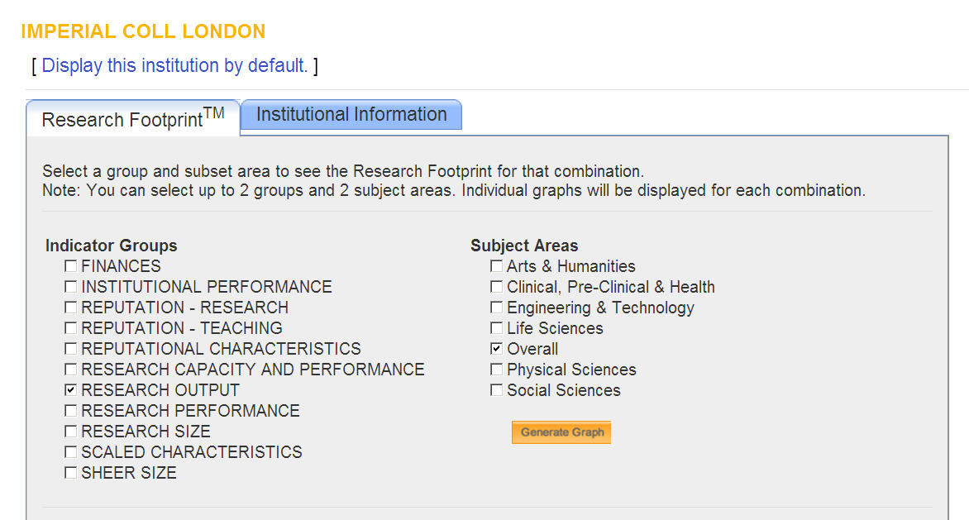
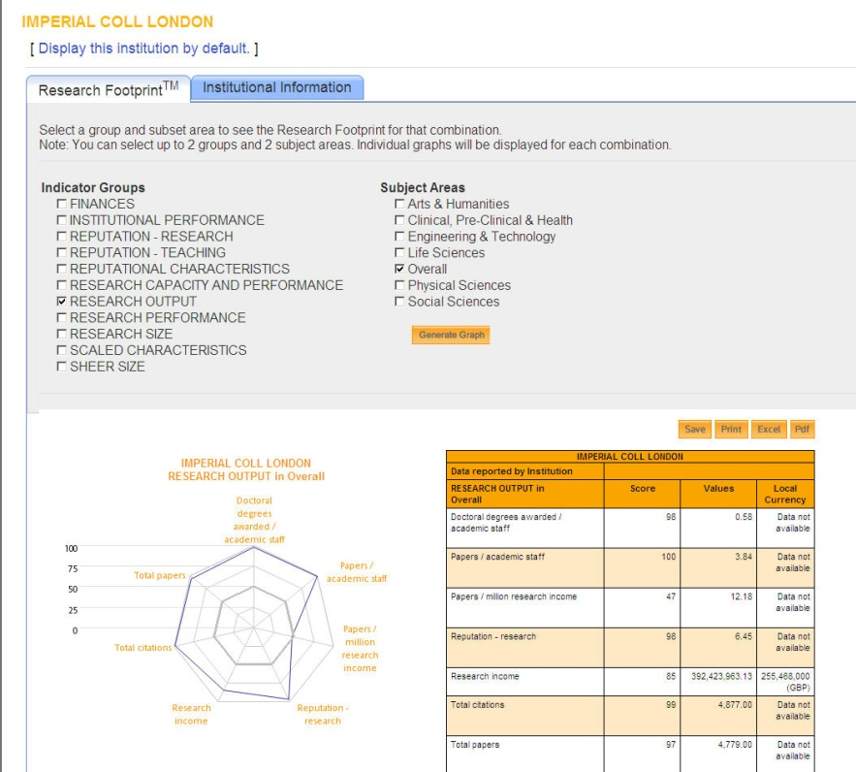
InCites – Institutional Profiles: View an Institutional Profile
Notes:
Data is MIT.

Slide 12
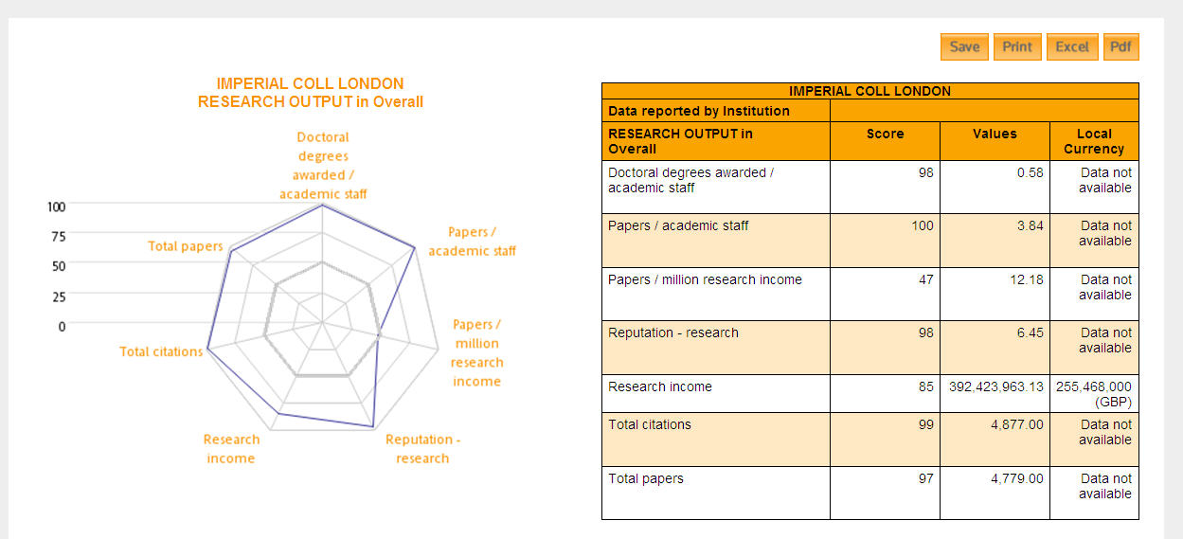
InCites – Institutional Profiles: View an Institutional Profile
The Research Footprint is a Radar Graph that illustrates the relative strength or weakness of performance indicators.
It is accompanied by a table containing three measures of size, strength or activity for each indicator
Notes:
Data is MIT.

Slide 13
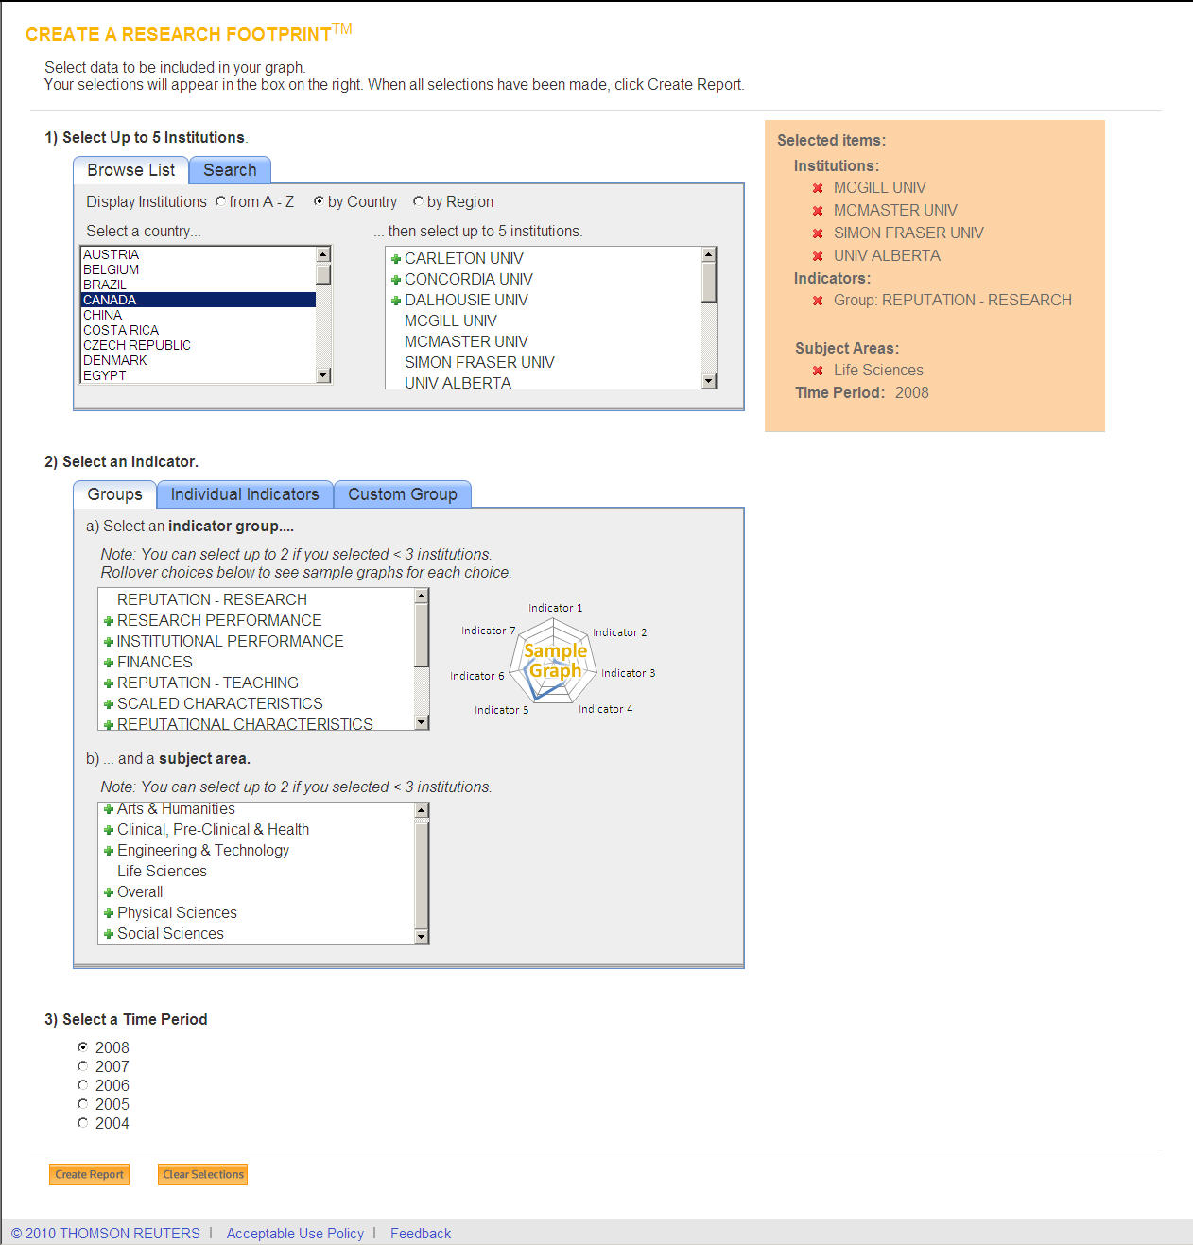
InCites – Institutional Profiles: Comparing Institutions
Selections:
McGill Univ, McMaster Univ, etc.
“Reputation – Research”
Life Sciences
2008
Compare Institutions through Creation of Research Footprints
Select up to five institutions.
Groups -- Each Indicator Group consists of between 5 and 9 indicators. For each group, one radar graph will be generated for each institution or country average you selected in step 1.
Notes:
Data is MIT.

Slide 14
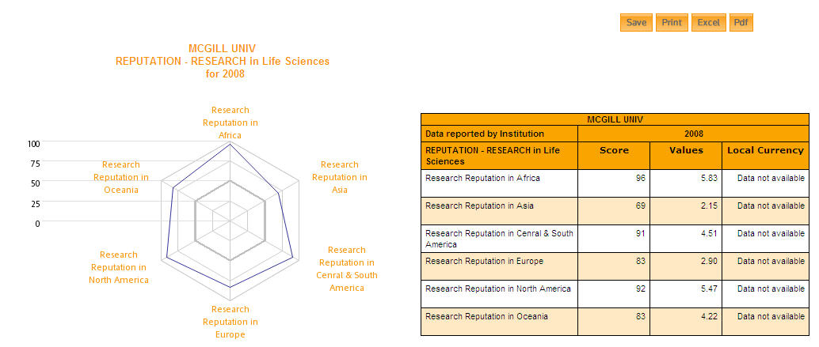
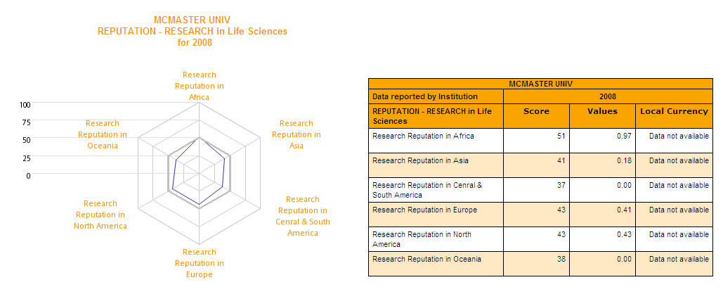
InCites – Institutional Profiles: Comparing Institutions
Selections:
McGill Univ, McMaster Univ, etc.
“Reputation – Research”
Life Sciences
2008
The Footprints provide an instant visual impression of comparative performance for this particular Indicator.
Notes:
Data is MIT.

Slide 15
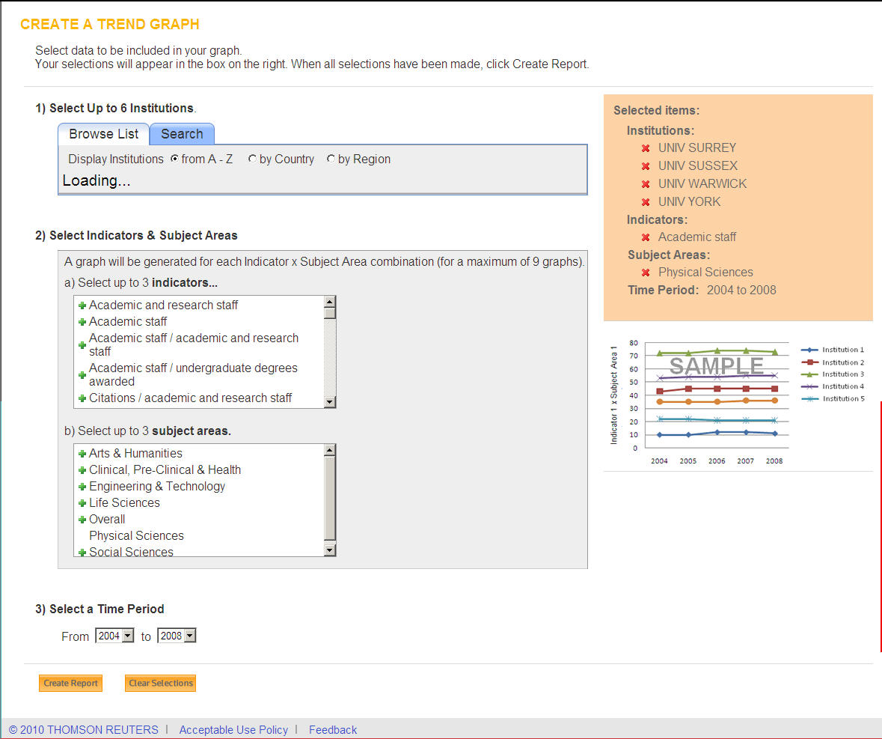
InCites – Institutional Profiles: Comparing Institutions
Compare Institutions through Creation of Trend Graphs
Select up to six institutions.
A trend graph illustrates the activity or progress of one indicator in one subject area.
1. Select at least one institution. You may select up to six. Each line on the graph will plot the activity, growth or progress of one institution.
2. Select an indicator and a subject area. Each point on the graph will represent a value of the selected indicator for each year. You may select more, but a graph is generated for each pairing of an Indicator and Subject Area.
3. Select a time period. Each point on the x-axis will be a year in the time period you specify.
Notes:
Data is MIT.

Slide 16
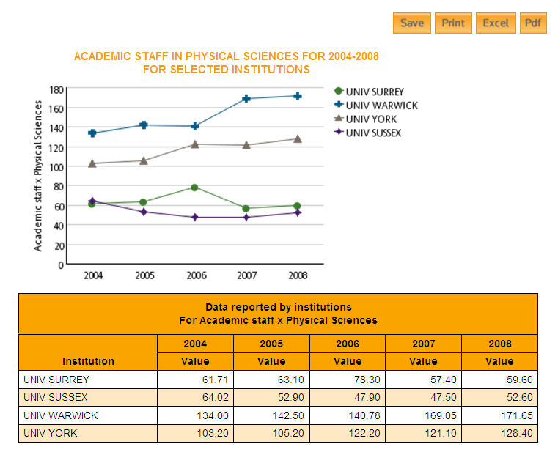
InCites – Institutional Profiles: Comparing Institutions
Notes:
Data is MIT.

Slide 17
INCITESTM INSTITUTIONAL PROFILES: an introduction
Informatio Scientifica / Informatio Medicata
September 2011
David Horky
Country Manager – Central & Eastern Europe
david.horky@thomsonreuters.com
Notes:
Welcome to this introduction to the global Institutional Profiles project. This short presentation will explain the basics of how the project is structured and overview of the some of the services that are possible with this rich source of data.

